Slide 1


Medicine Recommendation
This presentation explores a medicine recommendation analysis primarily using PySpark, along with supporting tools such as pandas, matplotlib, wordcloud, and Power BI. The study utilizes three main CSV files: Company_Name.csv, Medicine_description.csv, and Ratings.csv, which contain information about pharmaceutical companies, drug descriptions, and ratings.
Dataset Source: KAGGLE
https://www.kaggle.com/code/mpwolke/medicine-recommendation/input
Submitted By: SNEHA PAINULI Student ID: C0933116

Slide 2

Dataset Overview
1
Company_Name.csv
2
Medicine_description.csv
3
Ratings.csv
Contains Company Name, NSE Symbol, Rating, and Industry
Includes Short-form and Rating
Contains Drug Name, Reason and Description

Slide 3

Data Cleaning and Preparation
1
Removing Missing Value
Utilized PySpark functions to identify and handle missing values in all three datasets.
2
Data Transformation
Applied transformations to clean text data, including trimming whitespace and removing non-printable characters.
3
Duplicate Removal
Identified and removed duplicate entries to ensure data integrity.
4
Data Joining
Merged company and rating data based on short-form identifiers for comprehensive analysis.

Slide 4
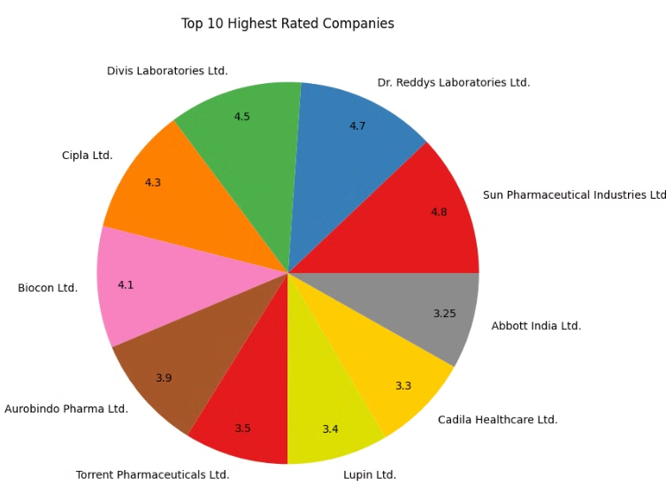
Top 10 Rated Pharmaceutical Companies
Insights
The pie chart provides a clear view of the market leaders in terms of ratings, helping to identify the most reputable pharmaceutical companies.The top-rated companies, such as Sun Pharmaceutical, Dr. Reddy's Laboratories, Divis Laboratories, and Cipla, dominate the pharmaceutical market. Their high ratings suggest strong customer satisfaction, reliable products, and effective medicines.

Slide 5
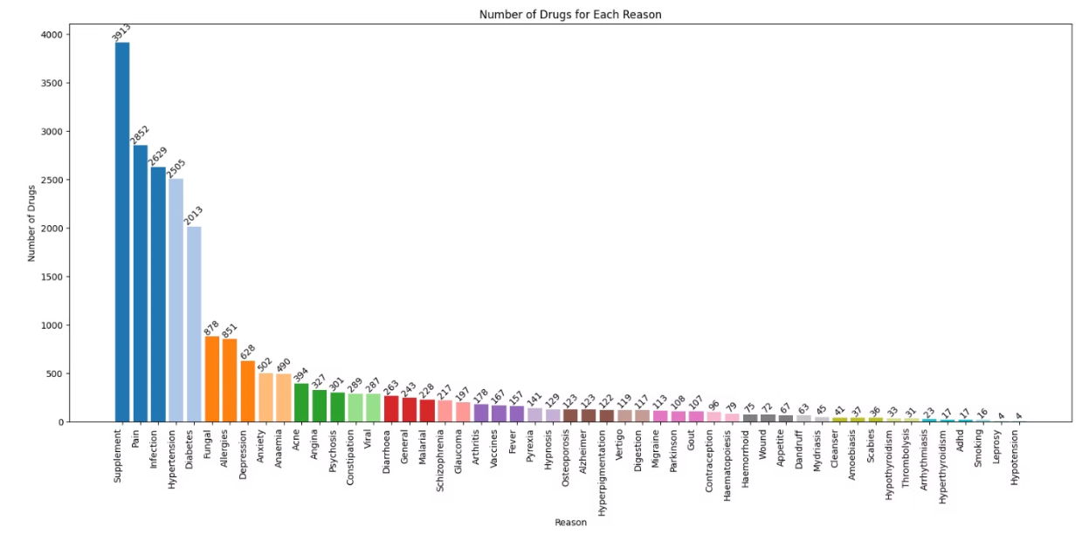
Drug Distribution by Medical Condition
Insights
This visualization helps identify which medical conditions have the most diverse range of drug options available.The distribution of drugs across different medical conditions can highlight the areas where pharmaceutical companies are most focused. For example, a higher number of drugs for "Supplement", "Pain", "Infection" or "Hypertension" indicates a higher prevalence or demand for treatments in these areas..The insight can help identify gaps in the market. If certain conditions have fewer available drugs, there might be an opportunity for pharmaceutical companies to develop new treatments in those areas.

Slide 6
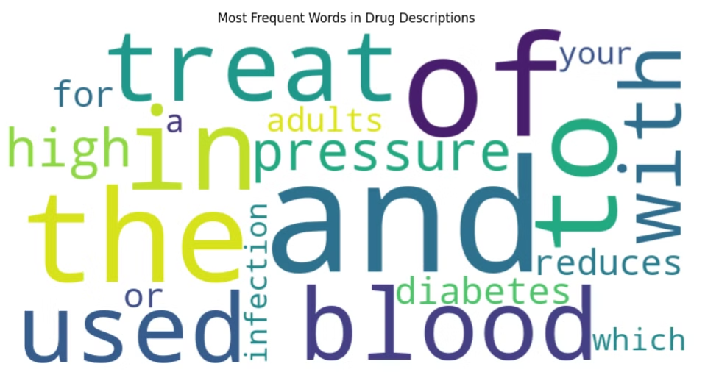
Most Frequent Words in Drug Descriptions
Insights
The word cloud highlights the most common terms used in drug descriptions, providing insights into frequently mentioned effects, conditions, or drug types. This helps in identifying the primary medical concerns that pharmaceutical companies target with their products.

Slide 7
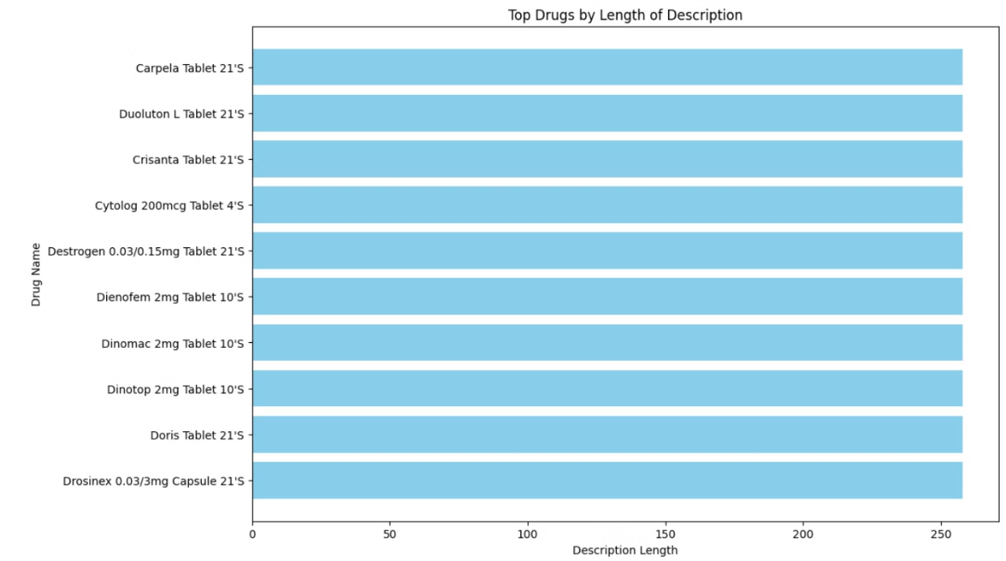
Top Drugs by Description Length
Insights
Identifies drugs with the most detailed descriptions about their uses, potential side effects, and instructions. This often indicates more complex or newer medications where detailed information is crucial for safe and effective use.

Slide 8
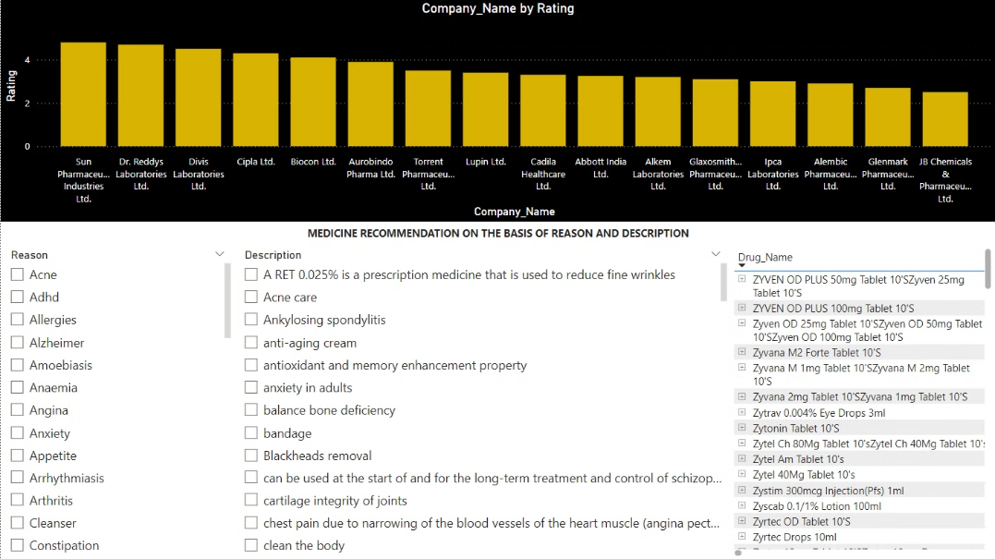
Medicine recommendation on the basis of Reason and Description
Insights
The list of drugs filtered by specific reasons and descriptions helps identify targeted treatments available for specific conditions. This can be used to analyze the variety of treatments available for certain conditions.
Understanding which drugs are available for particular reasons allows healthcare providers to make more informed decisions about prescribing the most appropriate treatment.

Slide 9
Project Conclusion
This project successfully demonstrated the value of data-driven approaches in medicine recommendation. By analyzing top-rated pharmaceutical companies and identifying common terms in drug descriptions, we provided insights that can guide patients and healthcare providers in making informed decisions. The ability to filter and recommend drugs based on specific medical conditions ensures personalized treatment options, improving patient outcomes.

Slide 10




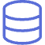
Business Use Case: Personalized Medicine Recommendation
Condition-Based Recommendations
The system allows healthcare professionals to input a medical condition and receive a list of recommended medicines, enhancing prescription accuracy.
Company Reputation Integration
By incorporating company ratings, the system helps in selecting medicines from reputable manufacturers, potentially improving treatment outcomes.
Detailed Drug Information
Provides comprehensive drug descriptions, enabling informed decision-making by healthcare providers and patients.
Data-Driven Insights
Offers insights into drug availability for various conditions, aiding in inventory management and drug development strategies.

